Slide 1
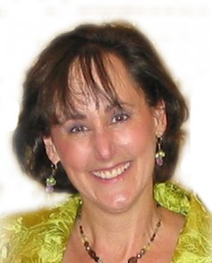
Let the Healing for Boring Bios Begin Because the Bio Doc is In!
Notes:
[Welcome]

Slide 2
A Gift To Guide You
Access a video presentation to create Bio Wow Now!
Here is the link – “copy and paste or retype” this link into your browser.
https://d26ehw723w44ow.cloudfront.net/121912_NancyJuetten.mp4

Slide 3
Today You Will:
Learn a five-step system that makes writing your bios fast and easy;
Grin at mis-steps to avoid;
Get inspired to start sharing YOUR story
And receive an invitation to go deeper in your learning AND benefit from “Bio Feedback” and personal attention from me to make your story better than ever!
Notes:
Today You Will: <CLICK>
Learn a five-step system that makes writing your bios fast and easy; <CLICK>
Get inspired by examples that brought in the business and the leveraged results; <CLICK>
Grin at mis-steps to avoid; <CLICK>
Get your questions answered; <CLICK>
And receive an invitation to go deeper. <CLICK>

Slide 4

Now … from UNKNOWN

Slide 5
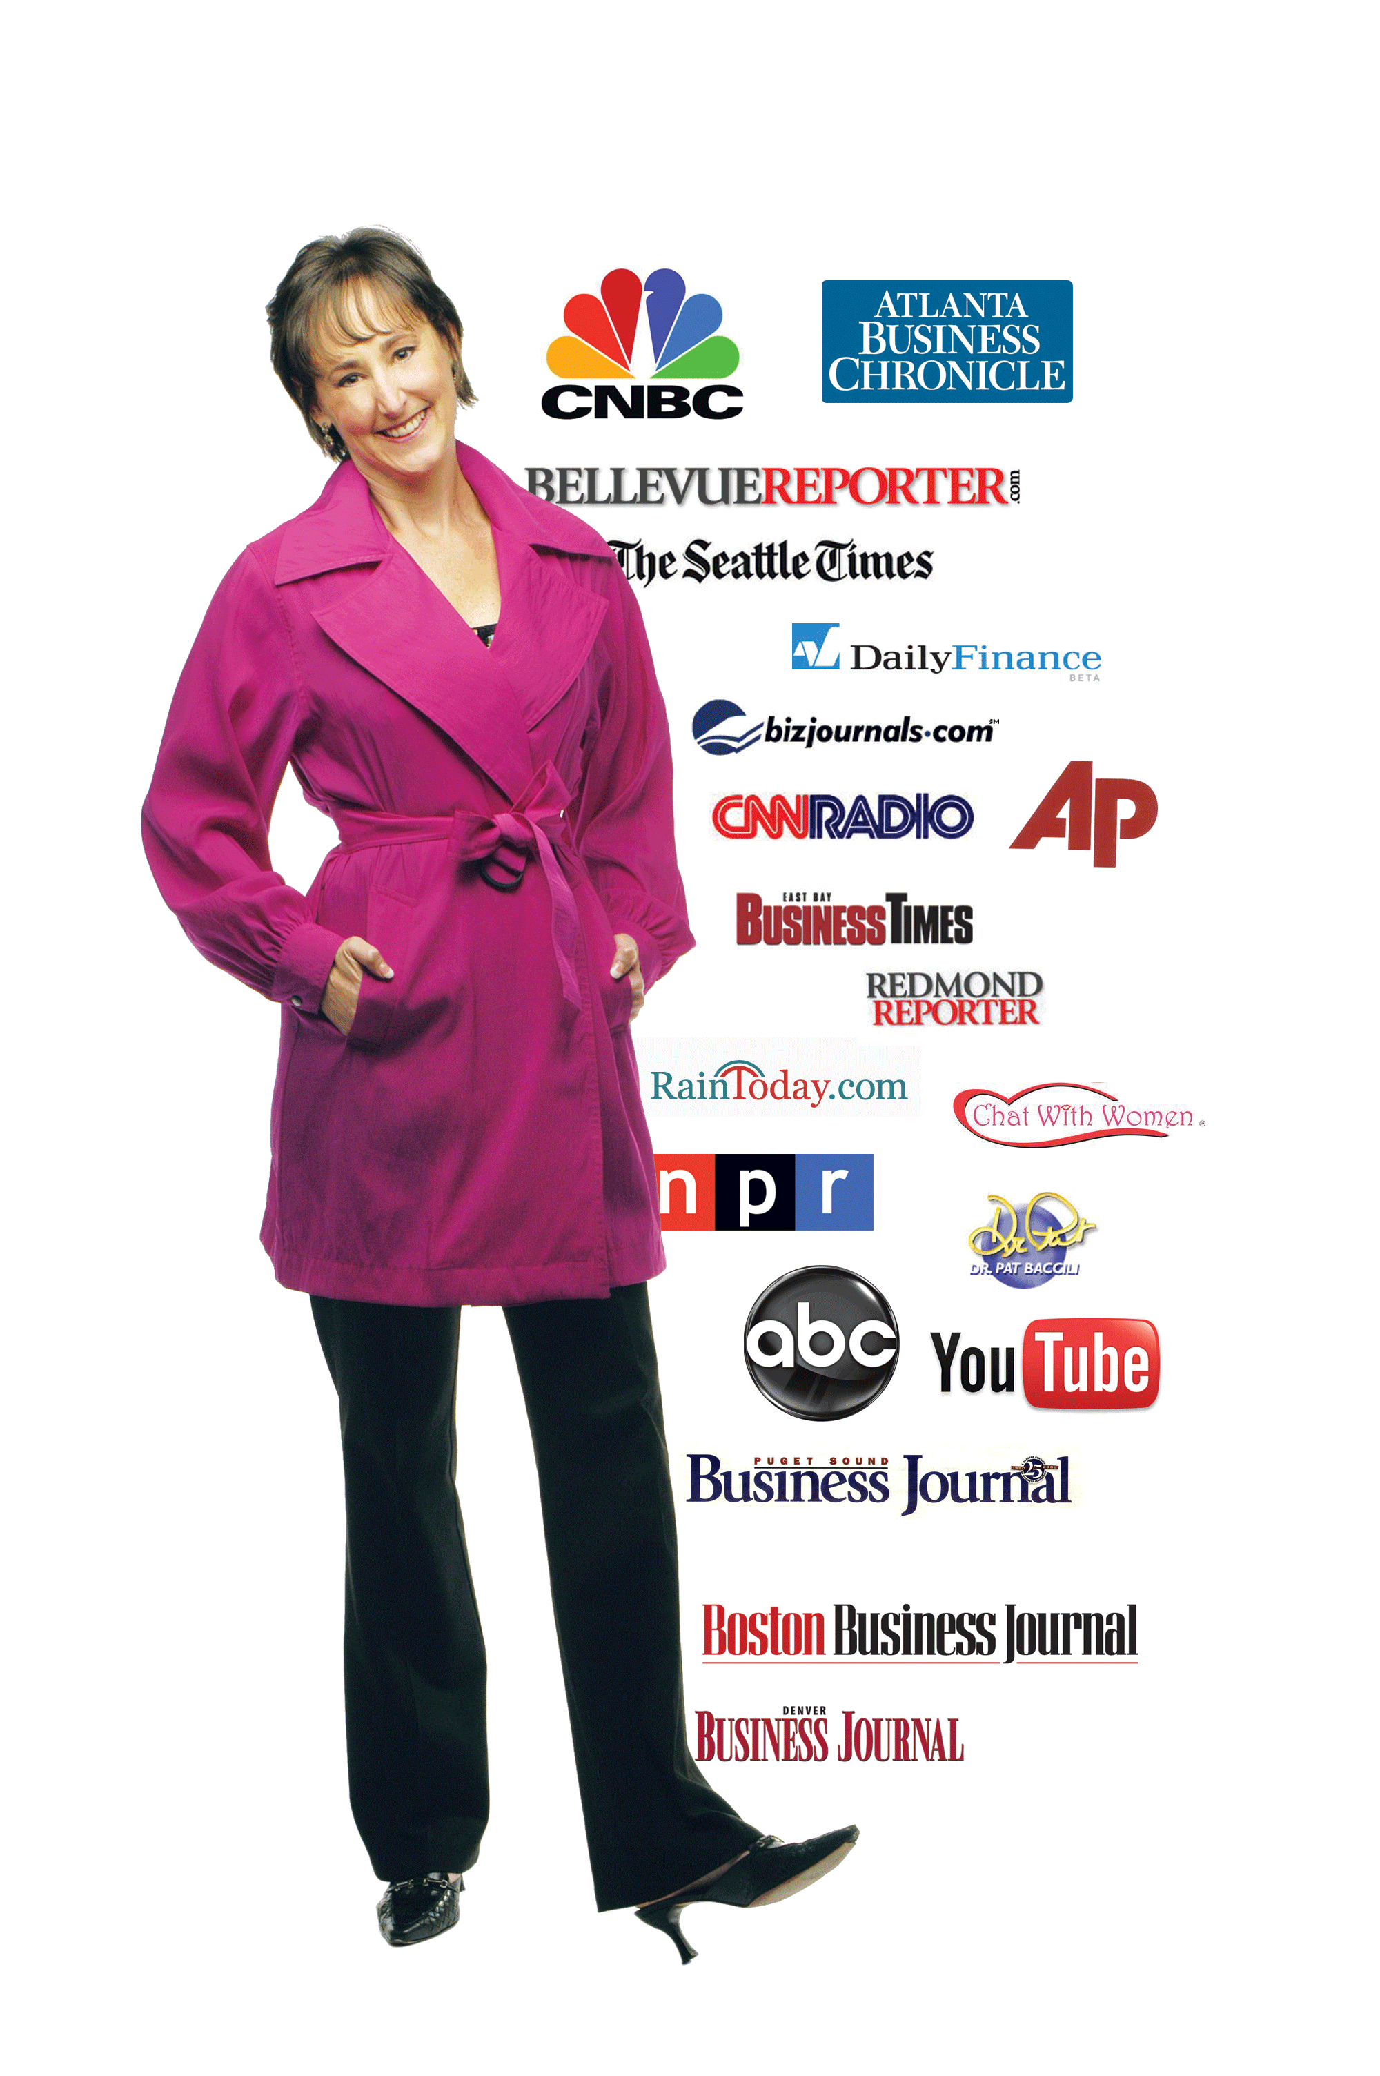
To KNOWN

Slide 6

You Can Make This
Transformation, Too.
Describe your WOW so you are excited and your ideal clients are, too.
Get known so you can get paid.
Make it happen by being consistent, tenacious, and READY.

Slide 7

What is YOUR Story?
Who are you?
Why does it matter?
Who do you serve?
In what ways?
What impact?
What sets you apart?
How can clients engage?
Are you ready?

Slide 8

Clear Objectives Lead to Clear and Winning Outcomes
Attract clients?
Speaking gigs?
Media interviews?
Notes:
Attract clients? <CLICK>
Speaking gigs? <CLICK>
Media interviews? <CLICK>

Slide 9
“Shed a Little Light So That We Can See”
— James Taylor
Remarkable
Memorable
Repeatable
Notes:
Memorable <CLICK>
Remarkable <CLICK>
Repeatable <CLICK>
Turn heads and invite people to lean in and want to know more.
Guide people to do what you want them to do.

Slide 10

How?
Make your story relevant to specific results you seek.
Use this simple five-step approach…
Notes:
Make your story relevant to results you seek. <CLICK>
Use this simple five-step approach….

Slide 11
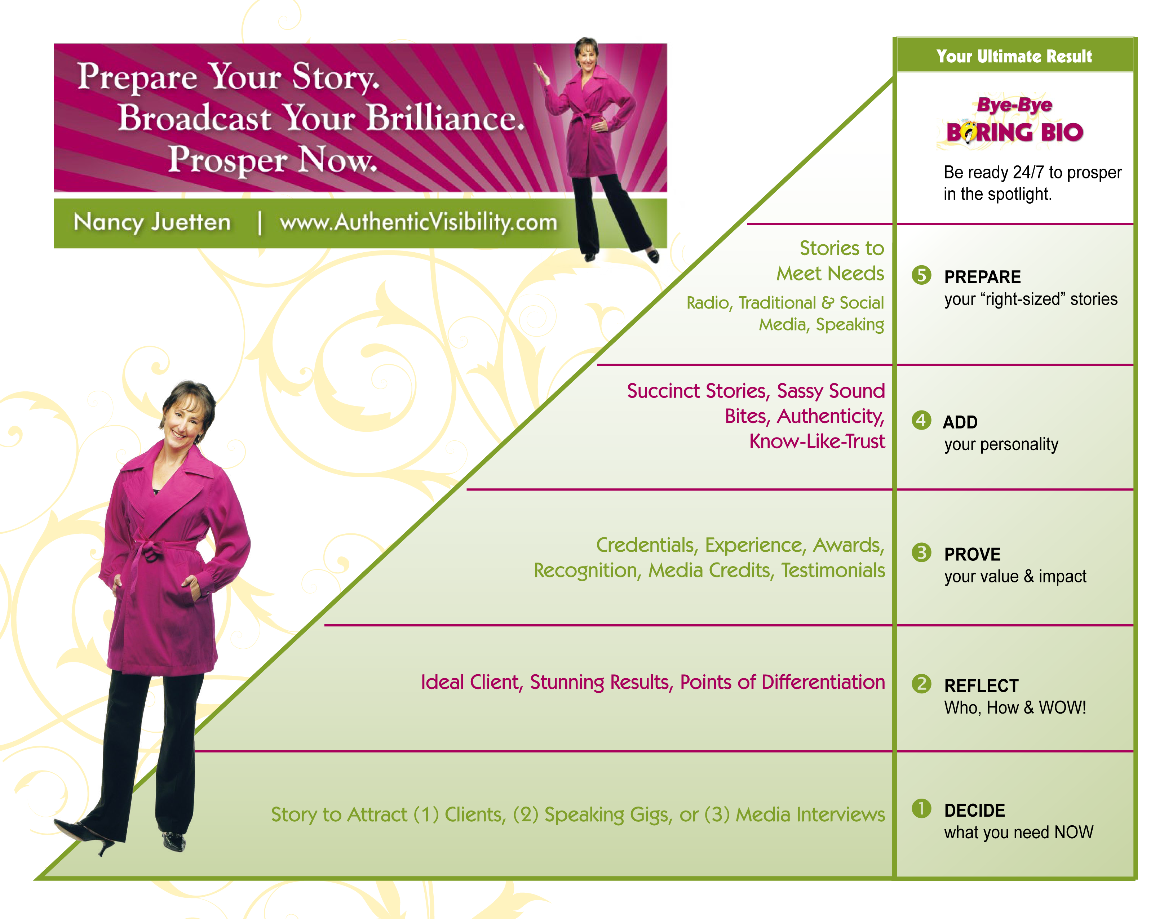
How to Be Ready for Opportunity in 5 Simple Steps

Slide 12
A
Audience
Arrogance
Alphabet Soup
Affability
What ACTION do you want the reader to take?

Slide 13
B
Blah, blah, blah
Boring
Boilerplate
(Don’t) Bury the Lead

Slide 14
C
Content – right the situation
Confidence

Slide 15
D
Differentiation
(Failure to) differentiate
Disclose how clients can benefit
Dare to discuss the dollars!

Slide 16
I
I-Disease
Every sentence starts with “I”

Slide 17
Y
Yada, Yada, Yada
Make every word count or leave it out
Brevity is beautiful

Slide 18
To Attract Your Best Clients,
Your Story Should…
Focus on outcomes, ultimate results, and WOW
Tell a story that gets the reader to YES fast.
Be clear about what you want the reader to DO.

Slide 19
Intoxicating Results!
$2500 engagement within two weeks of posting a new bio to a website;
Five-figure speaking gig within two weeks after turning three page speaker manifesto into one powerful page of WOW;
Six-figure annual executive coaching contract!

Slide 20

Healing for boring BIOs!

Slide 21
Client Attracting Bio Tempate #3
To the Rescue!
Less than one hour!

Slide 22
Amy Shapell, CFP www.finpath.com
“It takes as much energy to wish as it does to plan.” –Eleanor Roosevelt
I am fiercely committed to guiding busy working professionals, especially women, to achieve confidence and peace of mind around money so they can focus on what they want to achieve in life. If you’re looking for a proven professional who can guide you to answer questions like these, you’ve come to the right place:
Are you saving enough for retirement?
How about college?
Are you investments working as hard for you as they should and are they being managed effectively and efficiently?
Can you afford to work in a less lucrative career and be happier?
Are you and your spouse or partner on the same page about spending and saving (and, if you’re not, how can you find agreement)?
With almost ten years working with amazing clients with similar worries and concerns and guiding them to achieve remarkable success, my mission and commitment is to help you develop a clear vision for your life and then educate and empower you to make smart financial decisions to make that vision come true.

Slide 23
Jason Dorsey – The Get Y Guy™
Over 1000 Standing Ovations
Speaking fees start at $17,500
An internationally acclaimed keynote speaker, Jason has delivered 2,000 keynote speeches around the world. His dynamic speaking style has earned standing ovations from audiences as large as 13,000.
Contact us for your next generational keynote speaker.
MANAGING ACROSS GENERATIONS
SELLING ACROSS GENERATIONS

Slide 24
What If…
The perfect decision maker landed on your “about me” page?
A meeting planner landed on your site?
An influential reporter called and decided to interview you?

Slide 25
What Would It Feel Like If …
You were ready to respond to every opportunity like a pro with a message you love to share that turns the right heads every time?
No more 11th hour scramble
No more “message point SOS”
No more dropping other high priority balls to catch the one you weren’t expecting
No more “bio emergencies!”

Slide 26
More Success with Greater Ease
Make a GREAT name for yourself.
Pave a path to a winning reputation as an expert to be counted on.
Get invited back.
Opportunity would be calling YOUR NAME.
You’d be ready for anything and have a wait list of clients who can’t wait to work with YOU.

Slide 27

Reality Can Bite
Notes:
It can be hard to write about yourself.
You can waste a lot of time not getting it right.
It can be frustrating, not being able to see your own story in a way that will turn heads and invites the RESULTS you want most in your business.

Slide 28

“That’s Why I’m Here…”

Slide 29
Your Invitation Today
Purchase Bye-Bye Boring Bio Premium today.
www.authenticvisibility.com/BetterBioNowSH

Slide 30
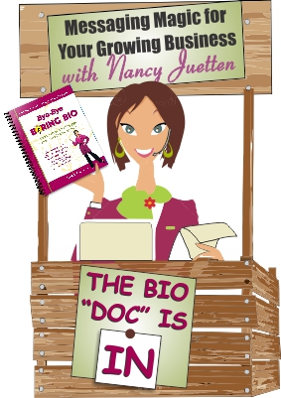
Special Bonus for Inspired Action
Go to the front of the line to Get Help during upcoming “Bio Doc is In” Sessions
Several calls are coming up soon.
Details are shared via my ezine.

Slide 31
Other Ways to Engage with Me
Get Known to Get Paid PRIVATE Mentoring Program
If you need one-on-one SUPPORT and REAL HELP to Get Known and Get Paid and are serious about taking an inspired six month journey with me as your mentor and guide, visit this link to learn more and apply:
www.authenticvisibility.com/private-mentoring-program

Slide 32
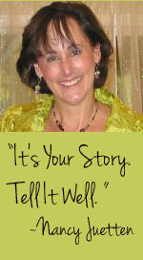
Parting Words
Every day is a chance for each of us to be important. Let today be that day for you.

