Slide 1
Have you ever felt stuck at the little kid’s table?

Slide 2
Me, Too!

Slide 3
Oprah Has the Right Idea! And the Answers are In This Room.
Notes:
The lessons we need and the support we need are all right there. We just have to make the decision to hang out with those folks and rise up to the challenges and opportunities that are within our reach. We can all step up to a bigger table, have more success on our own terms, and make a difference for those we are here to serve.
That means knowing who our people are, why we are the right talent to fill the need, being clear about how folks can engage us, and wanting it enough to keep fighting for it. That big table has a place for each and every one of us.
My speaking career took a huge leap as a direct result of being in one live event room just over a year ago. That same result can happen for those who want that outcome or even something better. How much do you want it and is now the time to take the medicine and be lifted up along your climb?
You surround yourself with people who can lift you higher. The answers we seek are all within this room

Slide 4
Come with me …
Notes:
Opportunity comes knocking when you least expect it. And it’s how you respond to that opportunity that can make the biggest difference.
Being ready counts for a lot. Come with me …

Slide 5
We have limited time.
Notes:
We must make the most of it. It’s a disservice NOT to.

Slide 6
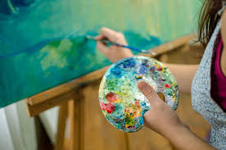
“If you want a masterpiece, master the pieces.” -- Hall of Fame Speaker Patricia Fripp

Slide 7
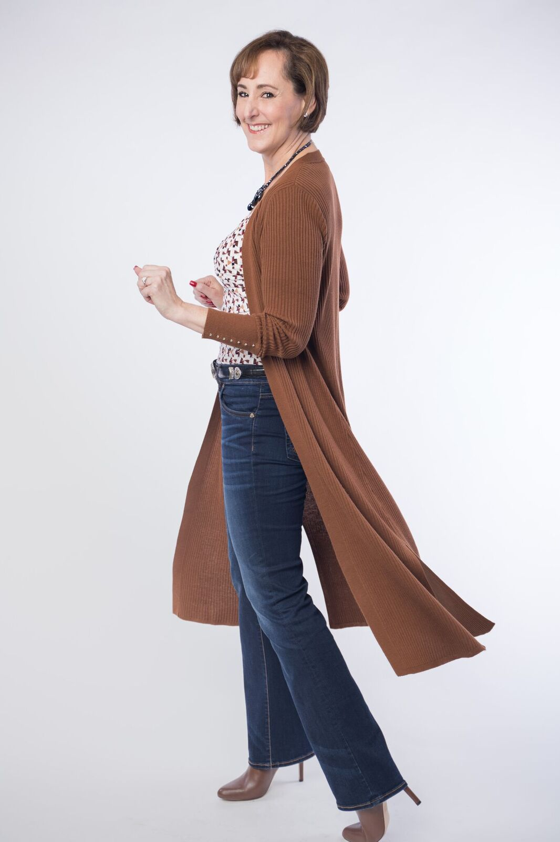
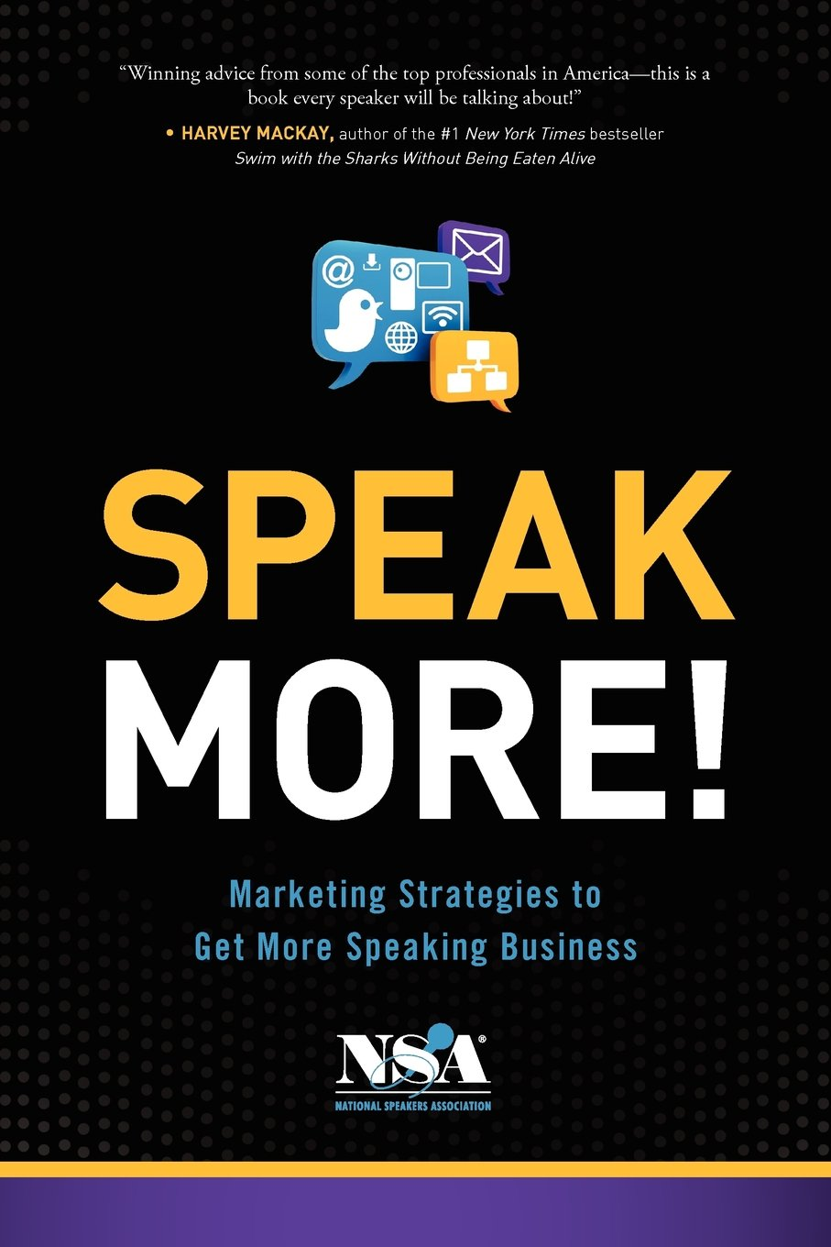
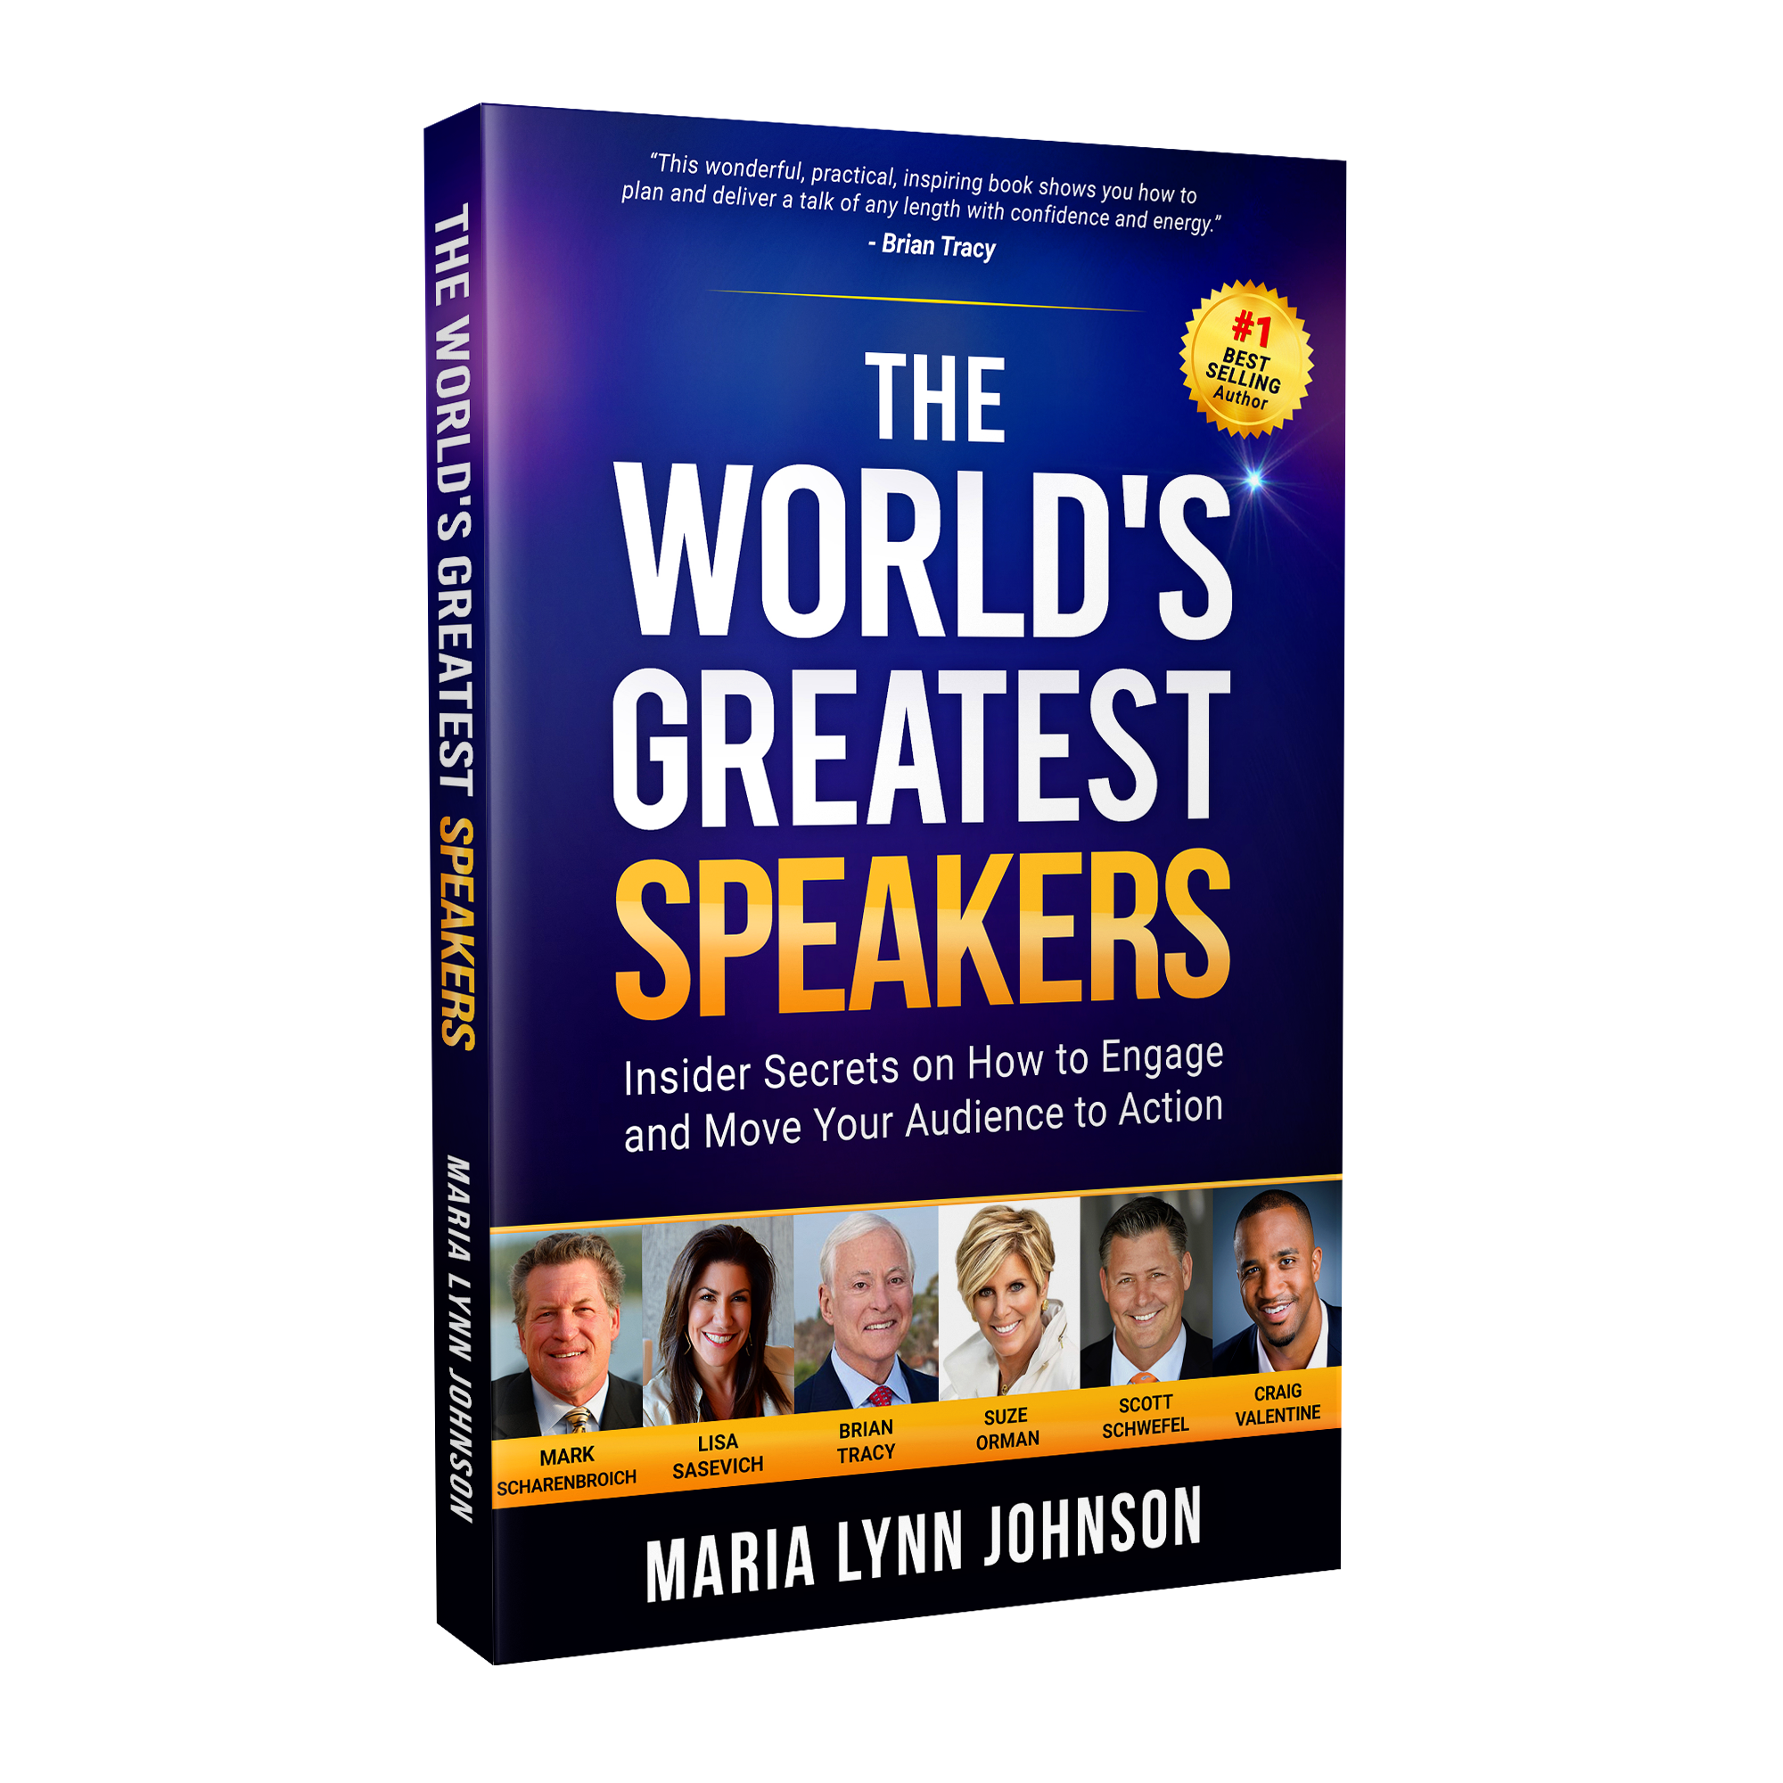
Spoke from 43 live or virtual stages in 2016
Notes:
I am the author of Bye-Bye Boring Bio, a contributing author to Speak More, and I took the live or virtual stage myself 43 times in 2016 to the right audiences to benefit from my message.

Slide 8
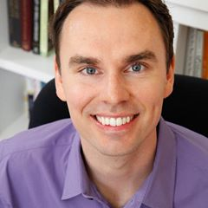
Shared the stage with big names
Notes:
International E Women Network Conference in Dallas, NSA International Conference.

Slide 9
2008

Slide 10
My Lowest Moment

Slide 11
A dare from a friend …
Notes:
I wrote a book in 3 weeks. Shared it with a small group. And got so many raves that I decided to sell it online. Orders came one right after the other. That book saved my bacon at the precise time I needed to bring it home. And I was off to the races in a new direction as an online marketer with a book that solved an urgent problem a lot of folks were struggling with. How to attract clients right away after being shown the door to corporate jobs.
Right away and to my surprise, I was invited to give interviews on radio, TV, telesummit, webinar. You name it. I did it. From my pajamas in the wee hours of the morning and from radio and TV studios. I made quite a name for myself and was ready for every opportunity. That helped me rise up from the ashes of my failed PR firm back to a six figure business within six months. And I’ve consistently brought in six figures or more to my business since then.

Slide 12
“Falling forward is better than standing still.” -- World Champion Toastmaster Darren LaCroix
Notes:
Have you ever said YES to a big opportunity, perhaps before you were ready? Me, too. With very humbling consequences. My coach in 2002 told me one arm of my success would be tied behind my back if I didn’t speak. So I went kicking and screaming to speaking. WBO luncheon story. It was an epic fail. And I had a choice. Quit or get better. That was my queue to study speaking and commit to getting better.

Slide 13
Became a pro at finding the gifts when things didn’t go well the first or second time …
Notes:
I knew I could help a lot of people around the world who were struggling with their message and niche audience. And I wanted to make my impact. So I kept falling forward in pursuit of that goal. And I became a pro at finding the gifts when things didn’t go well the first or second time.

Slide 14
Important lesson #1 Name and claim your profitable niche audience.

Slide 15
Important Lesson #2 Craft a talk that rocks the live or virtual stage.

Slide 16
Important lesson #3 Create a bio that attracts your IDEAL client at hello.

Slide 17
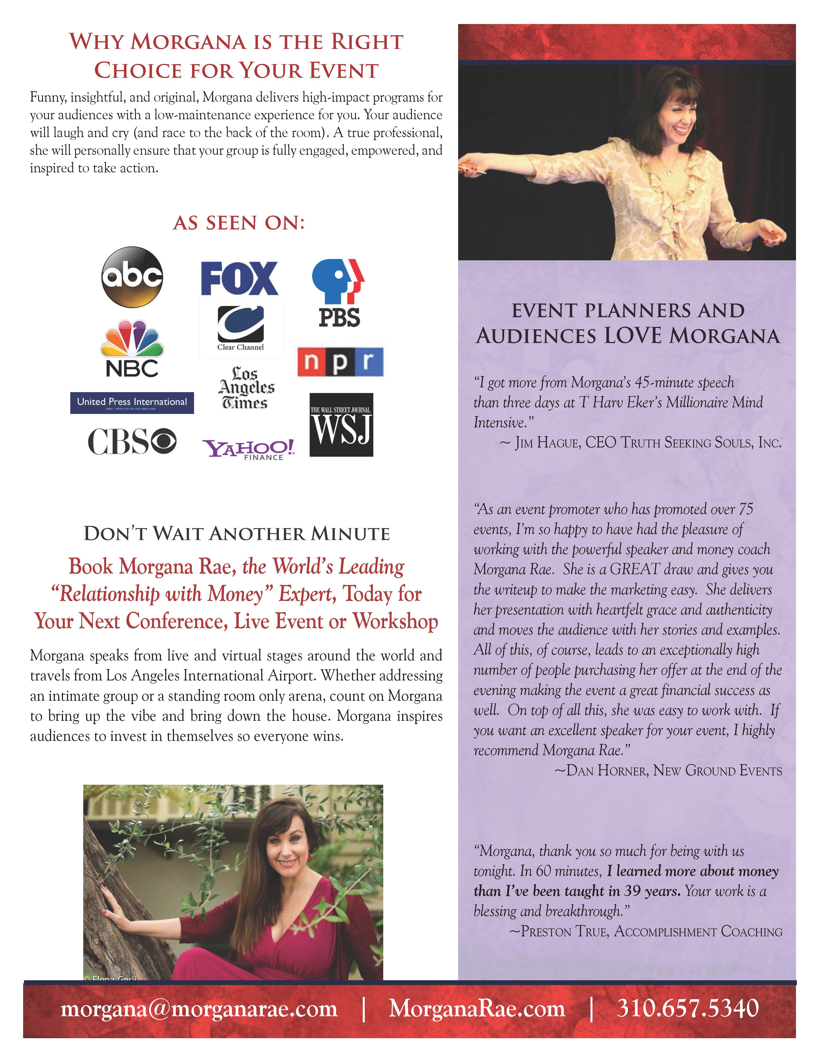
Important lesson #4 Craft a sizzling speaker sheet that gets you booked for the right audiences to benefit from your message.

Slide 18
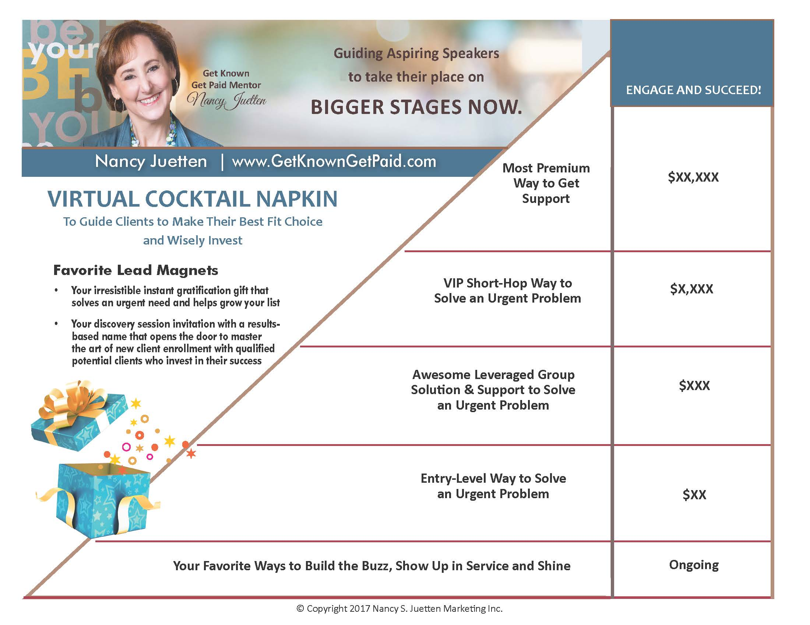
Important lesson #5 Offer a menu of ways clients can engage to benefit from your brilliance.

Slide 19
An Example for My Business

Slide 20
Important lesson #6 Master the art of new client enrollment.

Slide 21
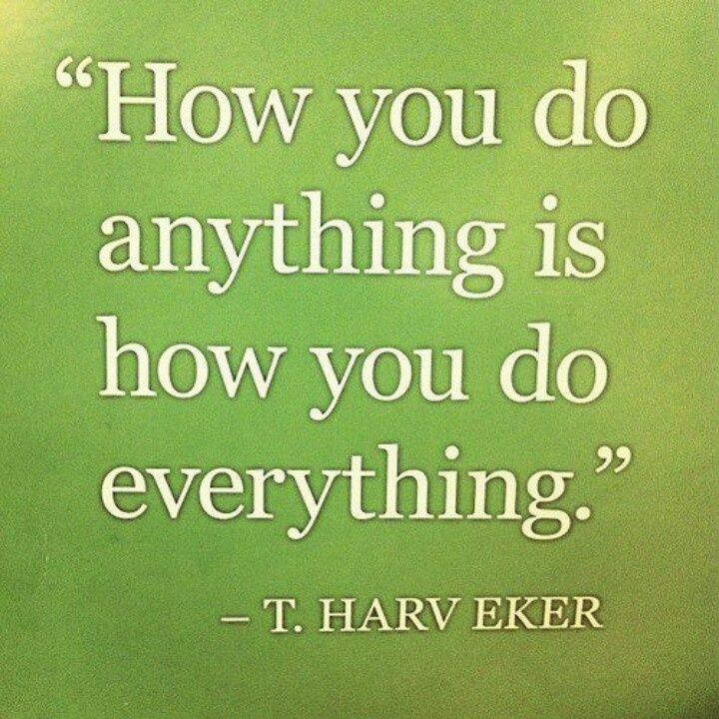
Important lesson #7 Show up at your best with every move you make.

Slide 22
Important lesson #8 Want your result enough to keep fighting for it, even when the going gets tough.

Slide 23
Important lesson #9 This one is a game-changer!

Slide 24
It can be daunting, exhausting, and takes time …
Notes:
Leading teleseminars
Building a responsive, loyal list of buyers, clients and champions
Creating lead magnets that convert
Setting up a shopping cart and learning how to use it
Becoming a trusted joint venture partner
Creating information products, packages that sell, and keynotes that inspire …

Slide 25
“Even if you go slow, you can still get where you want to go. -- Nan Crawford

Slide 26
What is the masterpiece you want to create?

Slide 27
“If you want a masterpiece, master the pieces.” -- Hall of Fame Speaker Patricia Fripp

Slide 28
Dr. Susan O’Malley
Notes:
Here is a woman who once applied to every medical school in the country and was rejected by all of them, only to reapply the following year.
She was 35 years old, pregnant without a husband. And she wanted to be a doctor. She was worried she was too old to get started. And her mother said, “Someday, you’ll be 50 years old. You can be a doctor at 50 … or not. Either way, it’s up to you.” So, she said yes to medical school and became an Emergency Room doctor.
She is the walking talking poster child of what it is to be an action taker, results maker, and never let excuses stand in the way of her dreams.
And, she knew there was more for her.

Slide 29
Before, Dr. Susan was on the sea without a compass …
Notes:
She left Emergency Medicine and launched a med spa to turn back the hands of time with needles and not knives. She was called to write a book and speak and join the NSA. And she didn’t know how. Here is where fate took a hand to both of our benefit. Dr. Susan O’Malley heard me speak on a telesummit. She decided to invest is a $97 information product. And then she joined a group program. And then she leap frogged into my Get Known Get Paid Private Mentoring Program to have my expertise and support all to herself.
She wanted to make success happen faster and easier with the support of a mentor who had ‘been there, done that, and already had the t shirt.”
Entrepreneur – Madison Med Spa
Called to become and author and speaker
Wanted to earn her membership in the National Speakers Association
Did not have a ‘sizzle reel’
Was not represented by a top speakers bureau
She didn’t know how do move forward …
So what has happened since?

Slide 30
Now, Dr. Susan is an author …

Slide 31
Entrepreneur.com Columnist …

Slide 32
A frequent Podcast guest …

Slide 33
Taking her place on big stages …

Slide 34
Soon to be represented by a leading speakers bureau

Slide 35
How did she make it happen?
She asked!
(And she invested in mentorship.)

Slide 36
These are fighting words …

Slide 37
She who DARES and PERSEVERES is she who succeeds
D --- Decide
A --- Ask and Apply While Always Aiming High
R --- Resist the Temptation to Quit
E --- Execute
Notes:
Seek Support .
Stay with It Long Enough to Succeed.

Slide 38
Success is an inside job.

Slide 39
“Do you want a masterpiece? Master the pieces.”
Notes:
And get expert support to fill in the gaps.

Slide 40
Visit www.sizzlingspeakersheet.com to download this gift template right now.

Slide 41
We’ll Answer These Questions Today
What kind of speaker are you?
What is your signature topic?
What are the 3 best audience take-away points
What do meeting planners and audience members say about your performances?
Do you have a book title that is relevant to your speech or a free opt in gift to share that is also relevant to your speech?
Have you been showcased in major media or shared the stage with luminaries with recognized names in your industry?
For advanced speakers: What percentage of the room do you typically convert to a sale?
Is your brief SPEAKER bio ready to share? (and your speaker intro, too!)
What is your sizzling call to action?

Slide 42
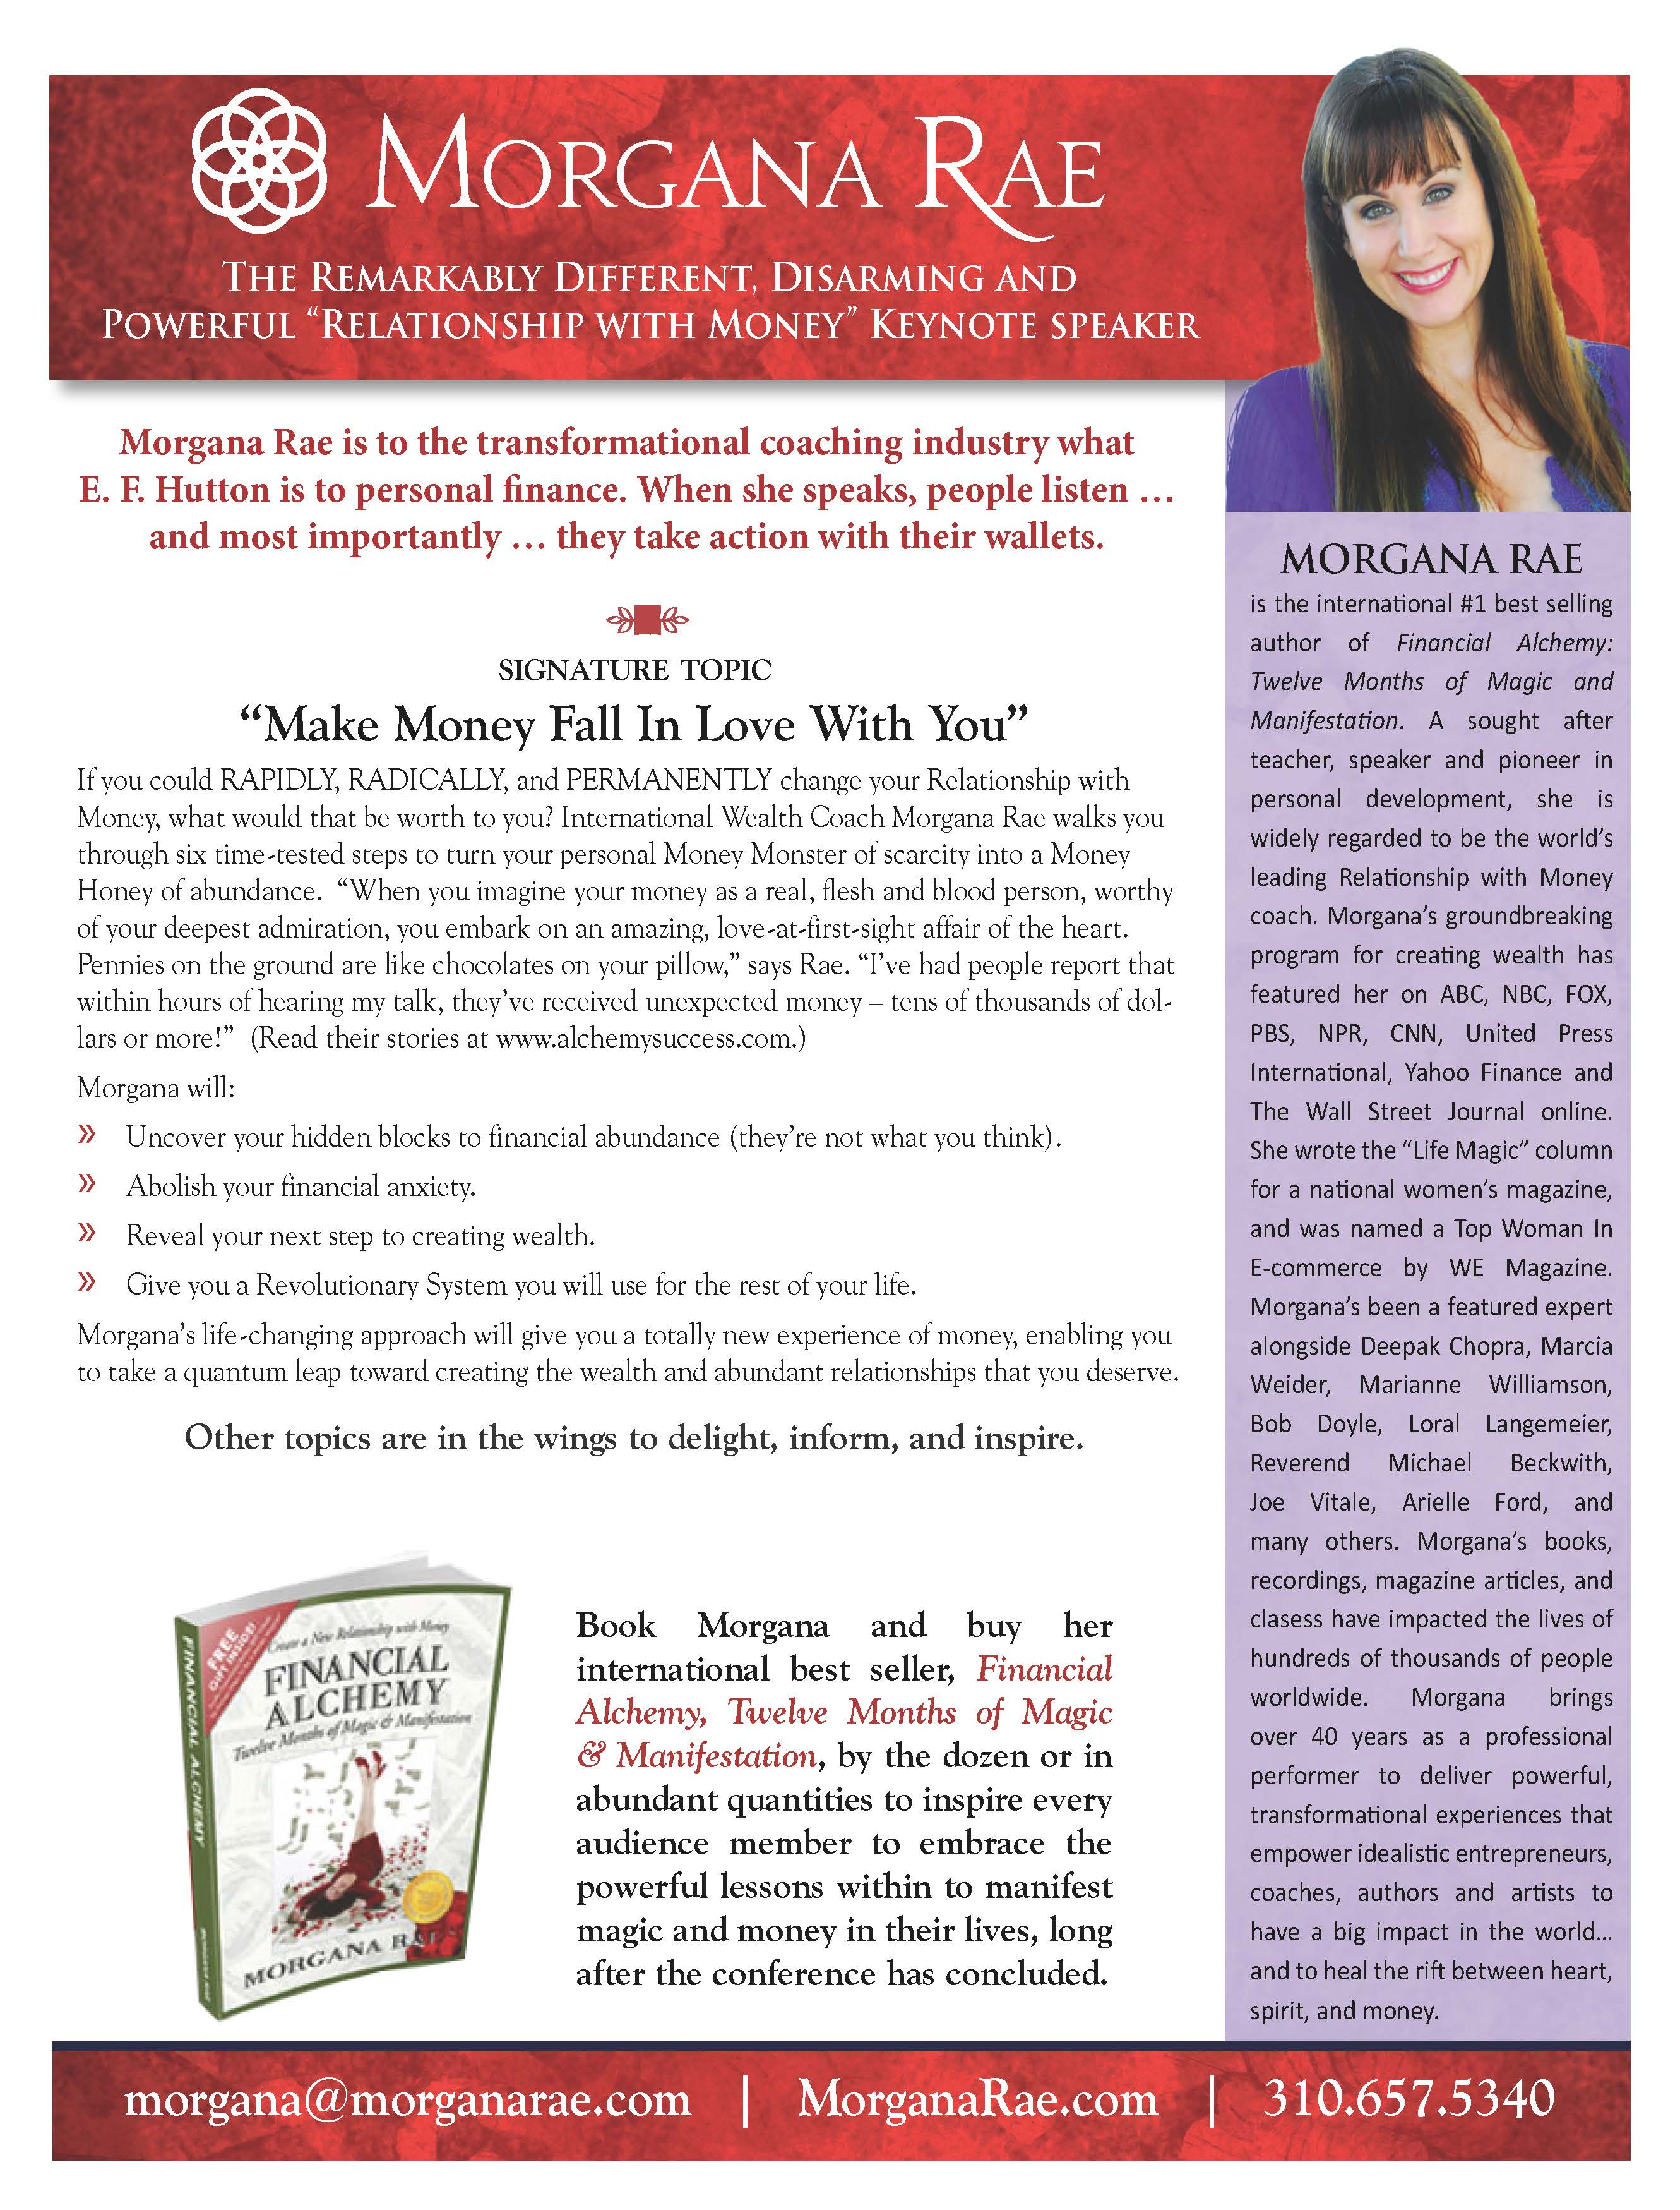

Slide 43
Side Two

Slide 44
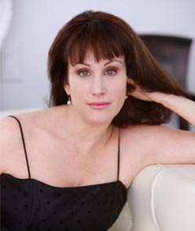
Morgana Rae Got Booked on a HUGE Stage within 24 Hours
"OMG! Nancy Juetten was able to see the things I didn't see, and say the words I wish I could say, to upgrade my Speaker 1-Sheet to the compelling and enticing calling card I needed before a meeting with the people whose stages I want to speak on this year. I can go to sleep tonight, knowing that I have exactly what I need to represent my best self. Thank you Nancy!"
-- Morgana Rae

Slide 45
What Kind of EXPERT Speaker are You?
Informational
Inspirational
Motivational
Transformational

Slide 46
Keynote Speaker or Workshop or Break-Out Session Leader?
Keynote
Workshop Leader
Break-out Session Leader

Slide 47
Which Category is Your Best Fit?
Leadership
Motivation
Sports
Career
Celebrity
Name Your Own!
Note: Don’t wimp out with ‘Author, Speaker, Coach.’

Slide 48
What are Your ‘Stand Out’ Qualities
Example:
Morgana Rae
The Remarkably Different, Disarming and Powerful ‘Relationship with Money’ Keynote Speaker

Slide 49
What are Your ‘Stand Out’ Qualities
In a world of ‘get to six figures fast’ experts, what sets YOU and your message apart?
What is your distinct point of view?
What do audience members say the most about what makes you memorable?

Slide 50
Every Speaker Needs Her Own Version of “Fire and Rain”

Slide 51
What is Your Signature Topic?
Make Money Fall in Love with You – Morgana Rae
How to be a Disruptasaurus – Get Noticed, Get Seen & Get Paid More for Your Know-How and Passion – Mike Koenigs
Transform Your Speaker-Sheet from Lukewarm to Sizzling to Get Booked Again and Again – Nancy Juetten

Slide 52
Hot Title Formulas
3 Massive Mistakes <ideal clients> Make That Keep Them From <desired outcome>
3 Dangerous Trends That Keep <ideal client> Struggling With <urgent problem>
3 Tricky Truths Most <ideal clients> Miss That Keep Them From <desired outcome>

Slide 53
More Examples
3 Mega Mistakes Coaches Make That Keep Their Group Coaching Programs Empty… And The #1 Secret To Fill Your Group Every Time (Michelle Schubnel – Group Coaching Success)
The Truth Behind the Business of Coaching: What You MUST Know to Get More Clients, Earn More Money and Make Your Biggest Impact (Melinda Cohan - Coaches Console)
Instant Client Formula: Discover the Fastest Way to Get a Rush of New Clients, Sell More Products and Build a Massive Mailing List (Rich German & Milana Leshinsky - Joint Venture Insider Circle)
The Badly Behaving Brain: Why 2 Billion People Can’t Lose Weight and What You Can Do Differently (Susan Thompson – Bright Line Eating Bootcamp)

Slide 54
What are Your 3 Most Compelling Audience Take-Away Points?
Audience members will:
Discover…
Reveal…
Identify …
Recognize …

Slide 55
What are Your 3 Most Compelling Audience Take-Away Points?
Audience members will:
Discover…
Reveal…
Identify …
Recognize …

Slide 56
What Do Meeting Planners and Audience Members Say about You?
Share ‘terrific specific’ quotes that reinforce your promise and get you booked again and again.
Kick ‘generic’ to the curb.
www.authenticvisibility.com/leave-a-testimonial
‘Plays well with others and is always a pleasure to have in class’ is a generic testimonial.

Slide 57
Do you have a book?
Share the cover
Invite orders by the dozen or by the thousand so the value you share from stage can live on long after the conference has concluded.
Example Image: Get my husband’s sample chapters at www.ditchtheguesswork-pinkspoon.com .

Slide 58
Media Coverage is a Credible Differentiator

Slide 59
Short and Snappy Speaker Bio
Let this bio showcase THE SPEAKER information that make you a ‘must select’ choice.
Do you want speaking gigs?
Let every word influence the decision maker to choose you.

Slide 60
What is Your SIZZLING Call to Action?
Don’t wait another minute. Book Morgana Rae, the World’s Leading Relationship with Money Expert Today for your next conference, live event or workshop.
Morgana speaks from live and virtual stages around the world and travels from Los Angeles International Airport. Whether addressing an intimate group or a standing room only arena, count on Morgana to bring up the vibe and bring down the house. Morgana inspir4es audiences to invest in themselves so everyone wins.
Phone
Email
Website

Slide 61
Voila!

Slide 62
Join me in the free public Raise Your Voice – Make Your Impact Facebook Group

Slide 63
Serious about Raising Your Voice and Making YOUR Impact with My Support? Ask for a VIP Chat at nancy@getknowngetpaid.com
Notes:
Serious. Know enough that I am the teacher to guide you forward.
Action taker. Results maker. No excuses. Ready to rock your results.
I’ll send you an application and I’ll meet with those who feel like a fit.

Slide 64
No more little kid’s table for you!

Slide 65
It’s Big Table Time.

Slide 66
Embrace Your Quirks. Raise Your Voice. Inspire & Lead.

