Slide 1
Welcome!
Get It Done Day Call #1

Slide 2
Welcome!
Thank you for getting on board, using all the tools and resources we’re providing to get your personal financial information organized.

Slide 3
Our Promise
You’ll get your crucial personal finance information organized.
You’re getting this done, and it’s going to be FUN!

Slide 4
‘Truck Stop’ Support
Join our client-only Facebook community
“I’m Ready for Anything Road Trippers”
Find it right here:
https://www.facebook.com/groups/lifegoesonroadtrippers/
Email: nancy@lifegoesonroadmap.com

Slide 5
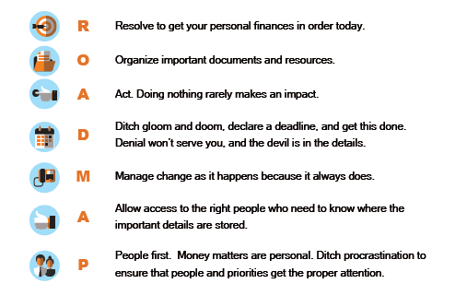
This is a slide title
Today We’ll Inspire You To …

Slide 6
Your Goal: Completion, Control, and Empowerment!

Slide 7
Tools for a Smooth Ride
Document box for important papers
File folders with tabs
A USB thumb drive
We recommend an ENCRYPTED thumb drive
A note pad so you can keep track of items that require additional follow up
Download a Timer application so you can have fun beating the clock as you complete each section of your Life Goes on Roadmap Organizer.

Slide 8
Fuel for the Journey!
Your favorite ‘dashboard dining’ for the road ahead
Beverages, snacks, and a tasty meal you can enjoy at mid-day.
Champagne and a way to celebrate when the day is done!

Slide 9
Assign Roles
Decide who will ‘drive’ for the first few stops along the journey.
This is the person typing information into the organizer.
Your partner can help find the documents that are needed, keep notes about follow up still required, and …

Slide 10
Tips for Morning Drive
To add additional information, put cursor to right or below and “enter”
Add notes to cells by right click, choose “insert comments”

Slide 11
Tips for Morning Drive
Read each section of Guidebook before entering information in Organizer
Hint: for service providers, look in checkbook and on recent credit card statement
Hint: for important documents, see checklist on page 26 of Guidebook

Slide 12
Goals for Morning Session
Complete all sections up to Insurance Information by noon
Have fun!
Remember to regularly save your Organizer to USB drive

Slide 13
Noon Office Hours
Event Title: Life Goes on Roadmap Get It Done Day Call #2
Date & Time: Saturday, March 9, 2019 at 12:00 PM Pacific
To attend this event, click here 15 minutes before the event time:
https://instantteleseminar.com/Events/113727126
If you don't have access to the web, you can listen in by dialing (425) 440-5010, and using the following conference pin: 293818#
If that number doesn't work for some reason, here is a list of alternative numbers, including international numbers: https://InstantTeleseminar.com/Local/?eventid=113727126

Slide 14
2 p.m. Office Hours
Event Title: Life Goes on Roadmap Road Trip Call #3
Date & Time: Saturday, March 9, 2019 at 2:00 PM Pacific
To attend this event, click here 15 minutes before the event time:
https://InstantTeleseminar.com/Events/113727189
If you don't have access to the web, you can listen in by dialing (425) 440-5010, and using the following conference pin: 293818#
If that number doesn't work for some reason, here is a list of alternative numbers, including international numbers: https://InstantTeleseminar.com/Local/?eventid=11327189

Slide 15
Vroom Vroom!

Slide 16
Let’s Get This DONE!

